Slide 1

Sinhgad College of Engineering Department of Computer Engineering
BE Project Stage I Presentation
on
Vidhan: A Gamified Approach to Learning the Indian Constitution with AI Assistance
by
Patil Yashkumar Shamkant [72231439G] [405B046]
Lomte Dhanashree Sanjay [72308274L] [405B007]
Patil Tejas Kailas [72231433H] [405B047]
Khedkar Aditi Ambadas [72308261J] [405B006]
Under the guidance of
Prof. R.A.Vasmatkar
Sinhgad College Of Engineering, Pune-41 BE(Computer)

Slide 2
Vidhan: A Gamified Approach to Learning the Indian Constitution with AI Assistance
Introduction
The Constitution of India is a vast, complex, and detailed document, making it difficult for many people to access, understand, and remember its important concepts.
Learning the Constitution is essential because it defines our rights, duties, freedoms, and the principles that guide our nation.
Knowledge of the Constitution helps every citizen students, adults, voters, and professionals to become more aware, responsible, and empowered members of society.
Everyone should have basic knowledge of the Constitution, as it directly affects daily life, decision-making, and participation in democracy.
To support the public in learning the Constitution in a simple, engaging, and interactive way, we are developing VIDHAN, a gamified learning platform with AI assistance.
Sinhgad College Of Engineering, Pune-41 BE(Computer)

Slide 3
Vidhan: A Gamified Approach to Learning the Indian Constitution with AI Assistance.
VIDHAN : Project Area
The project focuses on developing an interactive web platform that transforms learning about the Constitution into an engaging and game-like experience.
Domain: Ed-Tech (Educational Technology) & Civ-Tech (Civic Technology)
Subject Matter: The Constitution of India
Core Objective: To simplify complex constitutional articles, amendments, and legal principles through interactive gameplay.
The primary goal is to enhance constitutional literacy among citizens through gamification.
Sinhgad College Of Engineering, Pune-41 BE(Computer)

Slide 4
Motivation
Vidhan: A Gamified Approach to Learning the Indian Constitution with AI Assistance.
The "Boring" Barrier:
Traditional methods (dense textbooks, long articles) make learning the constitution feel difficult, not an opportunity. This alienates modern learners, especially students preferring interactive learning.
The Civic Knowledge Gap:
When learning is difficult, a knowledge gap forms. Many citizens don't fully understand their fundamental rights, duties, or how their government works.
The Power of Interactive Learning:
We can transform this topic by making it active instead of passive. Gamification and interactivity turn learning into an engaging experience that is rewarding and memorable.
The Ultimate Goal: Empowered Citizens
Sinhgad College Of Engineering, Pune-41 BE(Computer)

Slide 5
Vidhan: A Gamified Approach to Learning the Indian Constitution with AI Assistance.
Problem Statement
The Indian Constitution is lengthy, complex, and written in legal language, making it difficult for young students and the general public to understand.
Traditional learning methods are text-heavy and non-interactive, leading to low interest and retention.
There is no easily accessible, engaging, or gamified platform that simplifies constitutional concepts for all age groups.
Many citizens lack awareness of their rights, duties, and constitutional values, which affects informed participation in democracy.
There is a need for a modern, user-friendly, and AI-assisted system that makes learning the Constitution simple, enjoyable, and accessible to everyone.
Sinhgad College Of Engineering, Pune-41 BE(Computer)

Slide 6
Aim and Objectives of the project
Vidhan: A Gamified Approach to Learning the Indian Constitution with AI Assistance.
Aim : To transform constitutional education from a passive, text-based task into an engaging, interactive, and accessible experience that empowers citizens with functional knowledge of their rights and government.
Objectives :
Develop an Interactive Gamified Platform:
To build a user-friendly website featuring gamified modules, quizzes, and real-world scenarios that cover the constitution's every aspect.
Simplify Complex Information:
To translate the dense, formal language of the constitution into simple, clear, and relatable content suitable for a broad audience, especially students.
Sinhgad College Of Engineering, Pune-41 BE(Computer)

Slide 7
Vidhan: A Gamified Approach to Learning the Indian Constitution with AI Assistance.
Boost Learner Engagement:
To implement game mechanics like points, badges, and progress tracking to motivate users, encourage consistent participation, and make learning enjoyable.
Foster Practical Understanding:
To create content that connects constitutional concepts to everyday life, helping users understand not just what their rights are, but how they apply.
Promote Civic Confidence:
To equip users with the knowledge and confidence needed to become active and informed participants in the society.
Sinhgad College Of Engineering, Pune-41 BE(Computer)

Slide 8
Vidhan: A Gamified Approach to Learning the Indian Constitution with AI Assistance.
Literature Survey
01 - Paper Title: Constitution Connect: A Digital Platform for Promoting Constitutional Literacy Using MERN Stack
Publication: International Journal of Progressive Research in Engineering Management and Science (IJPREMS), 2024
Seed Idea (Core Idea):
Builds a digital learning platform that simplifies constitutional concepts for the public.
Uses MERN stack to provide blogs, quizzes, and a chatbot to support constitutional learning.
Focused on making the Constitution easy to understand, reducing legal complexity.
Drawbacks (Improved by VIDHAN):
Limited gamification basic quizzes only: VIDHAN adds full game-based progression, levels, rewards.
Focuses mainly on literacy: VIDHAN focuses on deep learning and interactive explanation.
Chatbot answers basic queries: VIDHAN uses AI-Chatbot assistance for personalized learning.
Sinhgad College Of Engineering, Pune-41 BE(Computer)

Slide 9
Vidhan: A Gamified Approach to Learning the Indian Constitution with AI Assistance.
Literature Survey
02 - Paper Title: LawKey — Law Constitution Chatbot
Publication: Institute of Electrical and Electronics Engineers SLAAI ICAI Conference, 2024
Seed Idea (Core Idea):
A chatbot using NLP + Reinforcement Learning to give legal guidance to users.
Extracts keywords from constitution texts and retrieves relevant laws.
Uses models like Word2Vec, TF-IDF, Rasa, Q-Learning to generate accurate legal responses.
How Chatbots Assist Learning:
Understand user questions in natural language and provide simplified legal explanations.
Reduce dependency on experts by giving instant, accessible legal information.
Reinforcement learning improves accuracy based on user feedback, making responses more relevant over time.
Helps users overcome complex legal language, improving clarity and understanding.
Sinhgad College Of Engineering, Pune-41 BE(Computer)

Slide 10
Vidhan: A Gamified Approach to Learning the Indian Constitution with AI Assistance.
Literature Survey
03 - Review Title: Gamification as an E-Learning Tool: A Literature Review
Publication: E-Learning Innovations Journal, 2024
Seed Idea (Core Idea):
Explores how gamification improves motivation, engagement, retention, and learning outcomes.
Reviews 53 studies showing the effectiveness of game elements in education.
Highlights the role of UI/UX, rewards, challenges, and interactive tasks in enhancing digital learning.
Positive Impact on Learning:
Gamification makes education more interactive and enjoyable, improving focus.
Enhances concept understanding by converting abstract topics into game-like experiences.
Encourages regular participation through points, levels, badges, leaderboards.
Helps learners relate better to society and civic topics by using real-world game scenarios.
Supports both self-directed learning and traditional learning environments.
Sinhgad College Of Engineering, Pune-41 BE(Computer)

Slide 11
Vidhan: A Gamified Approach to Learning the Indian Constitution with AI Assistance.
Literature Survey
04 - website Title: Centre for Law & Policy Research’s platform: ConstitutionofIndia.net
Platform: Website on Internet
Seed Idea (Core Idea):
ConstitutionofIndia.net is a digital platform created by the Centre for Law & Policy Research (CLPR).
It provides a comprehensive, authoritative, and research-based understanding of the Indian Constitution.
Contains historical documents, debates, amendment histories, comparative constitutional insights, and articles.
Designed for scholars, students, educators, lawyers, and the general public.
Scope of VIDHAN:
VIDHAN takes inspiration from the necessity of accessible constitutional knowledge.
Gamifies the learning experience with quizzes, games, levels, tasks, and challenges to make learning engaging.
Adds a Chabot assistant to answer doubts and user queries and customise learning.
Engages public with a simplified and interactive learning journey.
Converts static constitutional information into an interactive, enjoyable, and personalised educational experience.
Sinhgad College Of Engineering, Pune-41 BE(Computer)

Slide 12
Vidhan: A Gamified Approach to Learning the Indian Constitution with AI Assistance.
Scope of the project
Inclusion:
Development of an interactive web platform for learning the Constitution of India.
Integration of educational games, quizzes, and visual content to enhance engagement.
User-friendly interface suitable for students and general public.
Accessibility on both desktop and mobile devices for wider reach.
Detailed coverage of the Constitution of India.
Multilingual translation features.
AI-Assistance
Modules covering key topics such as Preamble, Fundamental Rights, Duties, and Directive Principles.
Exclusion:
Detailed coverage of advanced legal or judicial interpretations of the Constitution.
Offline learning or mobile app version (web-based only).
Real-time discussion forums.
Sinhgad College Of Engineering, Pune-41 BE(Computer)

Slide 13
Vidhan: A Gamified Approach to Learning the Indian Constitution with AI Assistance.
Software Requirement Specification
Functional Requirements:
User Management: Users must be able to register, log in, and manage their profiles.
Gamified Modules: The system will provide various interactive modules like quizzes, puzzles, and scenarios.
Progress Tracking: The platform must track and display user progress, scores, and achievements.
Leaderboard: A system to rank users based on their scores and display the rankings.
Content Management: An admin interface to add, update, and manage educational content.
Non-Functional Requirements:
Performance: Web pages and games should load within 3 seconds.
Usability: The interface must be intuitive, responsive, and accessible across major browsers and devices.
Scalability: The architecture must support a minimum of 1,000 concurrent users.
Security: All user data, especially personal information and passwords, must be encrypted and stored securely.
Reliability: The system should have an uptime of 99.9%.
Sinhgad College Of Engineering, Pune-41 BE(Computer)

Slide 14
Vidhan: A Gamified Approach to Learning the Indian Constitution with AI Assistance.
Software Requirement Specification
Hardware Requirements:
Server:
CPU: 2-core Processor
RAM: 4 GB
Storage: 50 GB SSD
Client:
A desktop, laptop, tablet, or smartphone with at least 2GB RAM and internet access.
Hardware Availability:
The required hardware for both server and client is readily available and consists of standard consumer and enterprise-grade components. No specialized hardware is needed.
Software Requirements:
Server:
Operating System: Windows, Linux (e.g., Ubuntu 20.04+)
Web Server: Apache Tomcat
Database: MySQL
Client:
A modern web browser (latest versions of Chrome, Firefox, Safari, or Edge).
Sinhgad College Of Engineering, Pune-41 BE(Computer)

Slide 15
Vidhan: A Gamified Approach to Learning the Indian Constitution with AI Assistance.
Methodology
System Architecture
The VIDHAN architecture is divided into interconnected modules / layers that work together to deliver a smooth user experience. Each module performs a specific function to ensure modularity and efficient data flow.
User Interface Layer:
This layer handles user interaction and interface presentation. It includes web pages for login, registration, content viewing, quizzes, playing games related to concepts and chatbot communication. It is developed using ReactJS, ensuring responsiveness and accessibility across devices.
Web Application Backend Layer:
The core logic of the platform resides in this layer, built using the Java Spring Boot Framework. It manages user authentication, session handling, quiz evaluation, chatbot responses, and data retrieval. The progress-tracking logic are also implemented here.
Sinhgad College Of Engineering, Pune-41 BE(Computer)

Slide 16
Vidhan: A Gamified Approach to Learning the Indian Constitution with AI Assistance.
Database Layer:
This layer manages data storage and retrieval using MySQL. It stores user profiles, quiz questions, progress records, and chatbot data. The database ensures secure access and fast response times through structured queries and indexing.
Chatbot Modules:
The chatbot acts as an intelligent learning assistant that interprets user questions using Natural Language Processing (NLP). It provides explanations of constitutional concepts, suggests relevant articles, and guides users through the learning process.
Games Modules:
The gamified component uses point systems, quizzes, badges, and levels to enhance motivation. Users receive feedback and progress updates, turning the learning process into an engaging experience.
Sinhgad College Of Engineering, Pune-41 BE(Computer)

Slide 17
Vidhan: A Gamified Approach to Learning the Indian Constitution with AI Assistance.
Tools & Technologies
Component Technology / Tool
Frontend ReactJS
Backend Java Spring Boot
Database MySQL
Chatbot Python (NLP,AI Model)
Gamification ReactJS Game Engine, CSS Animations
Hosting AWS
Version Control GitHub
Sinhgad College Of Engineering, Pune-41 BE(Computer)

Slide 18
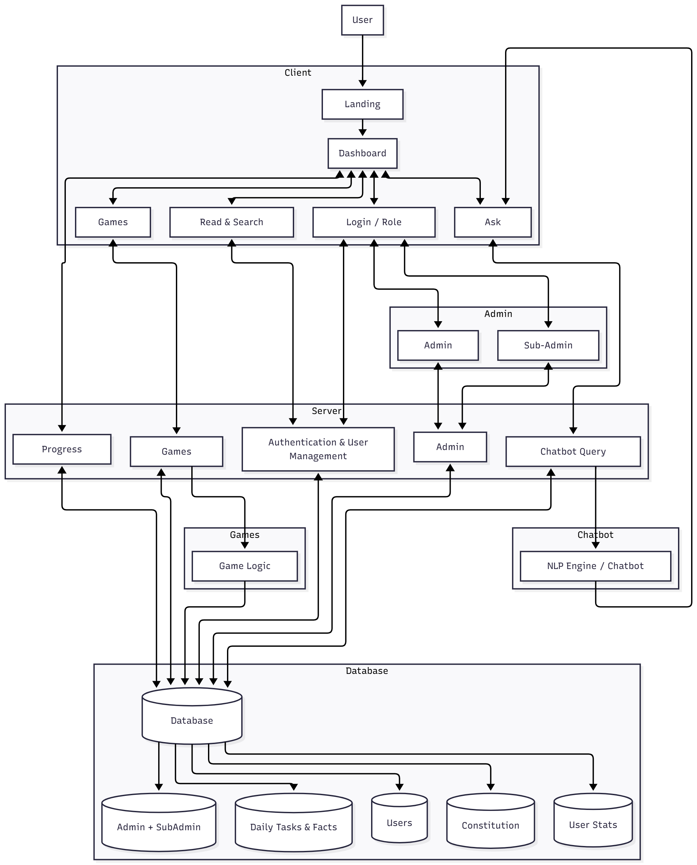
Vidhan: A Gamified Approach to Learning the Indian Constitution with AI Assistance.
System Architecture Diagram
Sinhgad College Of Engineering, Pune-41 BE(Computer)

Slide 19
Vidhan: A Gamified Approach to Learning the Indian Constitution with AI Assistance.
Gamification Implementation Example
EX-01: Article 21 - Right to Life & Personal Liberty
A fast-paced decision-making game where the player protects citizens’ fundamental rights by identifying violations.
Gameplay
Player must quickly click “Protect” if the scenario is a violation OR “Ignore” if it is not.
Example scenarios:
"Police arrest a citizen without reason" --> Violation --> Click Protect
"Government provides clean water" --> Not a violation --> Click Ignore
Timed gameplay: each round is 20 to 30 seconds.
Outcome: Players learn what real-life situations fall under Article 21 and how personal liberty can be violated.
Sinhgad College Of Engineering, Pune-41 BE(Computer)

Slide 20
Vidhan: A Gamified Approach to Learning the Indian Constitution with AI Assistance.
Gamification Implementation Example
EX-02: Preamble to the Constitution
Words from the Preamble are scattered randomly. Player must reorder them correctly.
Gameplay
Jumbled words appear as tiles.
Player drags tiles into correct sequence: WE, THE PEOPLE OF INDIA…
Timer increases challenge.
Stars awarded based on accuracy and time.
Outcome : Players memorize Preamble phrases through a fun puzzle mechanic.
Sinhgad College Of Engineering, Pune-41 BE(Computer)

Slide 21
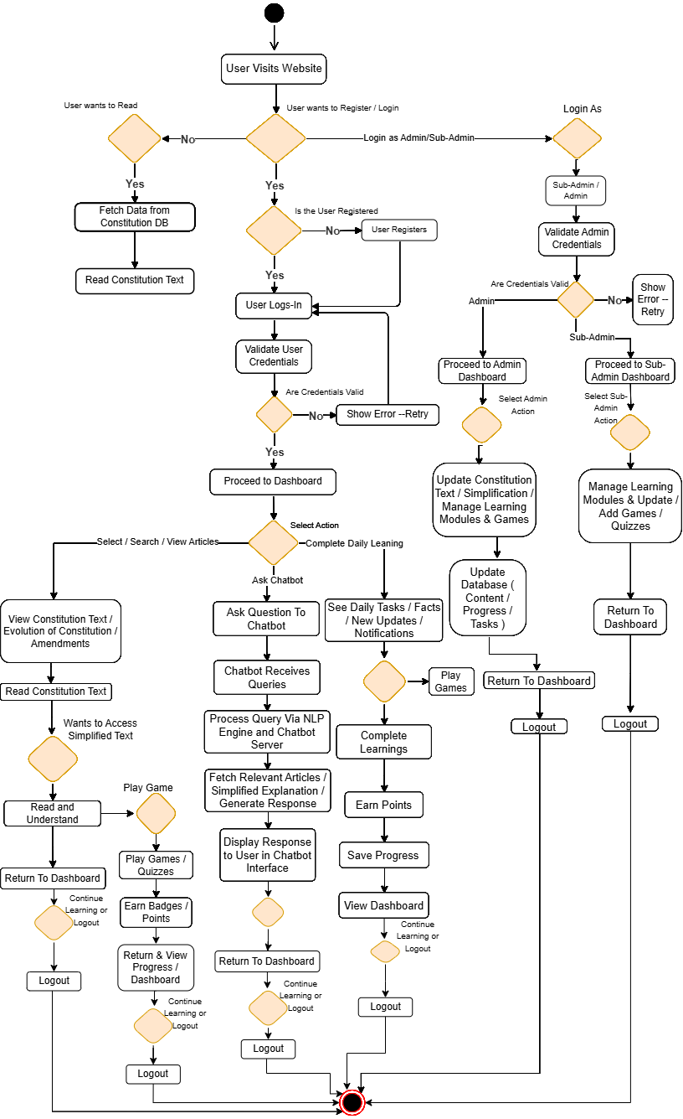
Vidhan: A Gamified Approach to Learning the Indian Constitution with AI Assistance.
Activity Diagram
Sinhgad College Of Engineering, Pune-41 BE(Computer)

Slide 22
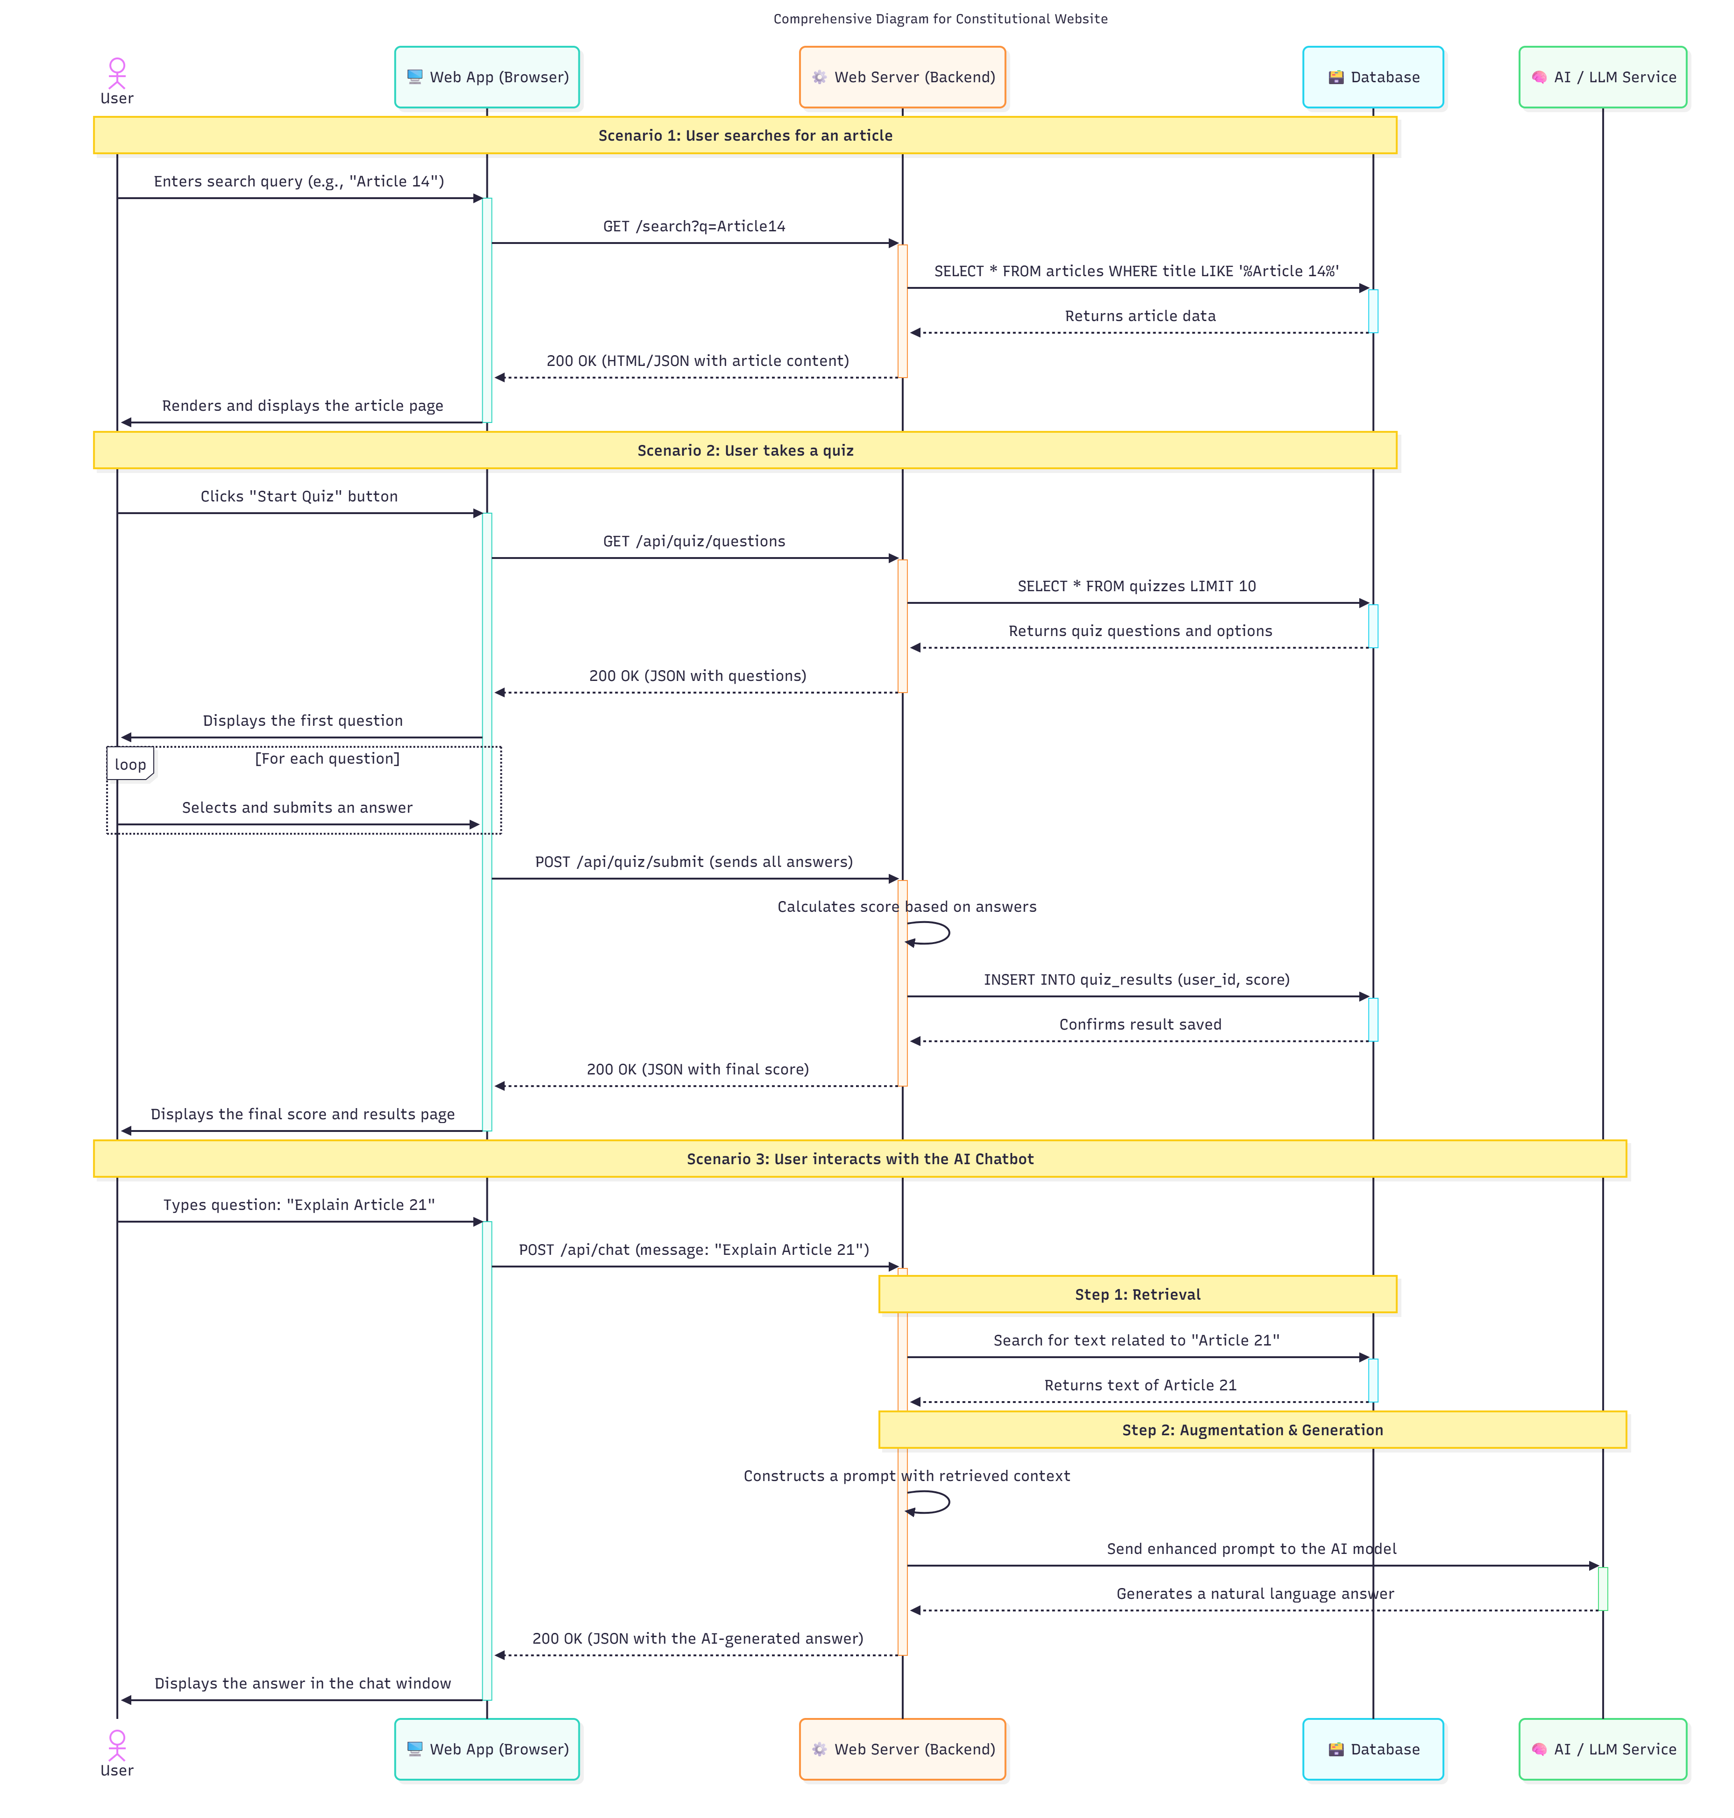
Vidhan: A Gamified Approach to Learning the Indian Constitution with AI Assistance.
Sequence Diagram
Sinhgad College Of Engineering, Pune-41 BE(Computer)

Slide 23
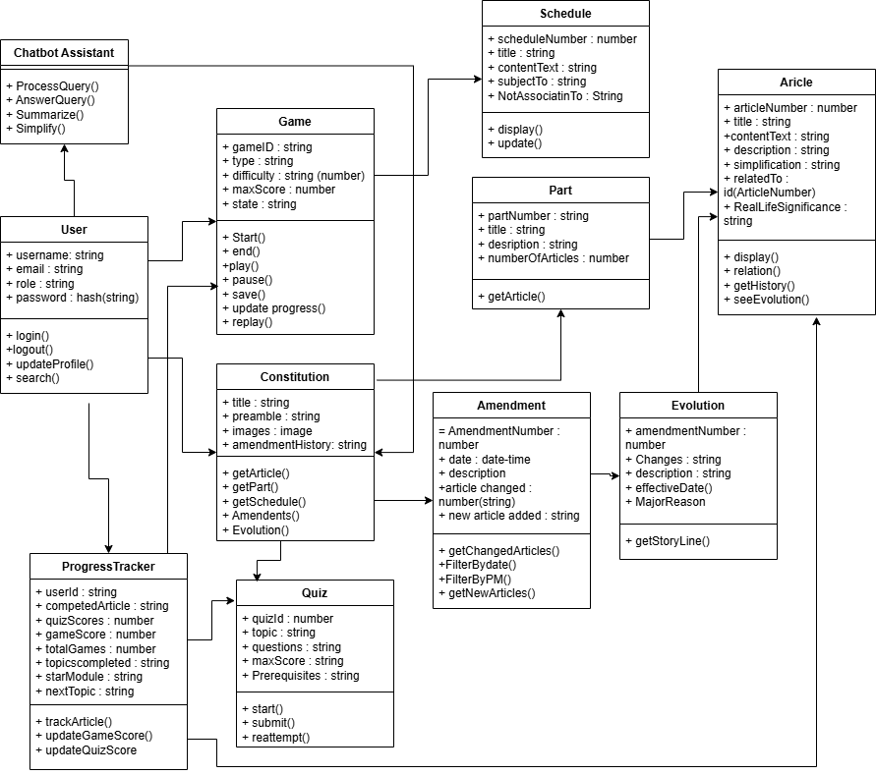
Class Diagram
Vidhan: A Gamified Approach to Learning the Indian Constitution with AI Assistance.
Sinhgad College Of Engineering, Pune-41 BE(Computer)

Slide 24
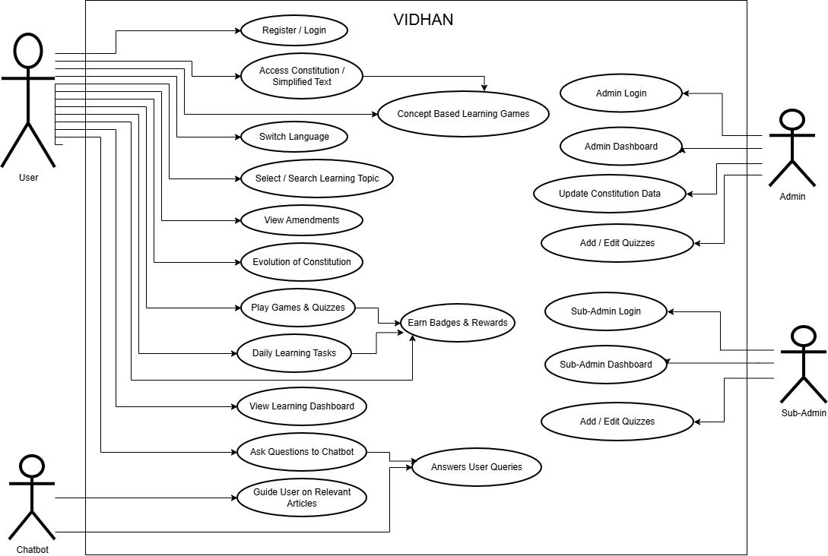
Vidhan: A Gamified Approach to Learning the Indian Constitution with AI Assistance.
Use Case Diagram
Sinhgad College Of Engineering, Pune-41 BE(Computer)

Slide 25
Vidhan: A Gamified Approach to Learning the Indian Constitution with AI Assistance.
Conclusion
The VIDHAN platform will make the Indian Constitution easy to learn by converting complex legal language into simple, interactive content.
Through gamification, it will increase engagement, helping users learn Articles, Rights, Duties, and the Preamble in a fun and memorable way.
The integrated AI chatbot will act as a personal learning assistant, giving clear explanations and answering user doubts instantly.
The project will promote constitutional awareness, empowering students and citizens with practical knowledge of their rights and responsibilities.
By combining education, gameplay, and AI, VIDHAN will bridge the gap between civic knowledge and modern digital learning, contributing to a more informed society.
Sinhgad College Of Engineering, Pune-41 BE(Computer)

Slide 26
Vidhan: A Gamified Approach to Learning the Indian Constitution with AI Assistance.
Future Scope
Content Expansion: Introduce modules on landmark Supreme Court cases, historical context, and comparisons with global constitutions.
Enhanced AI Capabilities: Develop more advanced AI features, including personalized learning paths based on user performance and Socratic-style debate simulations.
Community & Collaboration: Launch multiplayer games, class leaderboards, and teacher-focused dashboards to build a collaborative learning community.
More Content: Adding historical case studies and comparing constitutions from other countries.
Team Competitions: Introducing multiplayer quizzes, team challenges, and national leaderboards.
Mobile App: Launching dedicated apps for Android and iOS for learning anywhere.
More Languages: Adding support for various regional languages to reach more users.
Integration of: Bharatiya Nyaya Sanhita (BNS), Bharatiya Nagarik Suraksha Sanhita (BNSS), and Bharatiya Sakshya Adhiniyam (BSA).

Slide 27
References
Vidhan: A Gamified Approach to Learning the Indian Constitution with AI Assistance.
[1]. S. Naveen, M. Salmaan, and E. Sivamuthu. "Constitution Connect: A Digital Platform for Promoting Constitutional Literacy Using MERN Stack" International Journal of Progressive Research in Engineering Management and Science (IJPREMS), vol. 04, no. 12, pp. 948-952, [Year - 2024]
[2]. W. S. Fernando, M. Handapangoda, M. Gamage, N. Samindi, and D. Alwis, "LawKey - Law Constitution Chatbot" in 2024 8th SLAAI International Conference on Artificial Intelligence (SLAAI-ICAI), 2024, doi: 10.1109/SLAAI-ICAI63667.2024.10844946. [Year - 2024]
[3]. P. Halachev, PhD in Informatics and Computer Science, Assistant Professor, Department of Informatics, University of Chemical Technology and Metallurgy, Sofia, Bulgaria "Gamification as an e-learning tool: A Literature Review" E-Learning Innovations Journal, vol. 2, no. 2, pp. 4-20, 2024, doi: 10.57125/ELIJ.2024.09.25.01. [Year - 2024]
Sinhgad College Of Engineering, Pune-41 BE(Computer)

